Slide 1
Parenting a Blended Family
Presented by Tonya and Rodney Nichols

Slide 2
What to Try and What to Try to Avoid
There are NO Right or Wrong Ways
EXCEPT When it’s Done God’s Way!

Slide 3
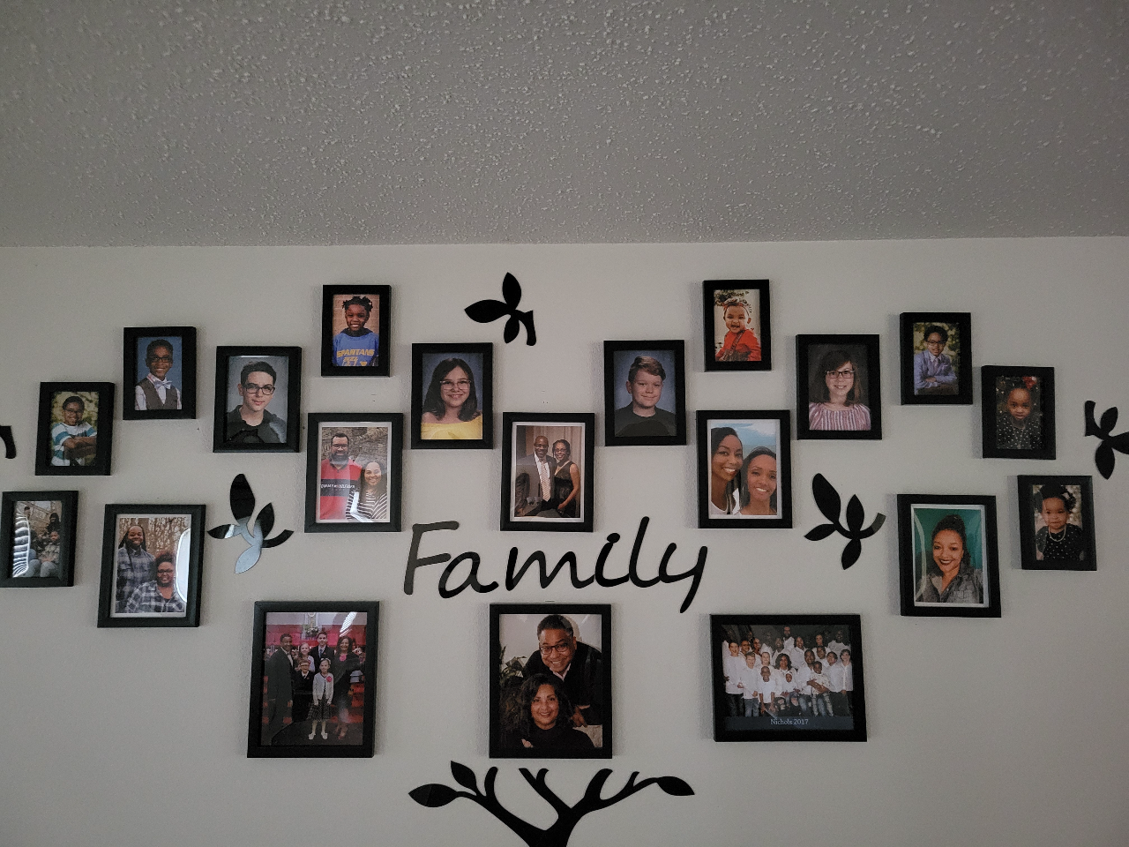

Slide 4
Opening Question:
How do individuals' parent a diverse blended family?
Answer: By parenting the way our Heavenly Father Parents us!

Slide 5
Part One ~ The Tonya and Rodney Story
We had a rough start to our marriage
So thankful our plan was NOT God’s Plan
We had to confess, ask forgiveness and move on
We had to KNOW God’s Word and work to become equally yoked

Slide 6
Part Two ~ It would have been good if everyone liked the idea of a biological blended family
Understand the total dynamics of everyone involved
Know that we are products of our environment
Ephesians 5:31 tell us to leave our parents and cleave to our spouse
It’s help to have a village to help raise children as long as the village has it together

Slide 7
Part Three ~ Let’s make it clear, “You ain’t my Momma and you definitely ain’t my Daddy
Remember that there will almost always be an emotional and biological connection between children and their parents and maybe even their grandparents
Consider, an apple tree can’t be changed to be a pear tree, BUT if nurtured it can be the BEST apple tree ever!
As parents do you really want your children to be just like you?

Slide 8
Part Four ~ We will give this “thing” a try, BUT I still don’t like it.
Begin with the end in my, which for us was a loving family!
Express to all the children that God brought us together
Stay focused on parenting like God parents us
Try new ways to show unconditional love and bring the family together
Listen and be alert, God will give His guidance and it won’t always make sense at the time

Slide 9
Part Five ~ Even biological families don’t get along all the time!
Think about it, how many times did you want to choke your siblings
Mom and Dad and sometimes the Grandparents would make us Fire Mad and all they were doing was trying to was make us a better person
Know that children change and parents don’t have to change with their children, just be there with unchanging, unconditional love when they need you.

Slide 10
Part Six ~ Love is the Key
For God so loved the world that He gave......
Parenting a blended family requires a lot of giving with very little return at times
Remember that you can’t beat God Giving

Slide 11
Part Seven ~ Everybody stay in their lane.
Be the best parent(s)you can be
Be the best child(ren) you can be
While always “Honoring your Mother and Father” for life!
As blended family parents, we have a very Special God Purpose (most likely you will NOT see it coming)
Add to your goals to be Kingdom Building Parents that are raising Kingdom Building Children who eventually become Kingdom Building Parents that raise Kingdom Building Children

Slide 12
Part Seven ~ Everybody stay in their lane.
Be the best parent(s) you can be
Be the best child(ren) you can be
While always “Honoring your Mother and Father” for life!
We stay in our lane as parents by making sure that through this journey our children know and apply the Wisdom found in the book of Proverbs
Help our children to be the best they can be, while letting them be their own person (the toughest job is not giving advice to adult children unless you are asked)

Slide 13
Love Unconditionally! God loves Us unconditionally! We all will miss the mark, and God will always be there with open arms.
As parents, our primary task is to love each other as spouses and as parents. We must model love as we love our spouse and love our children.
Conclusion:

