Slide 1
Parenting class

Slide 2
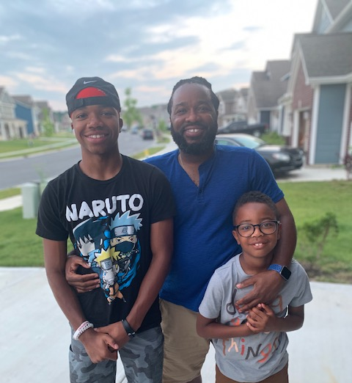
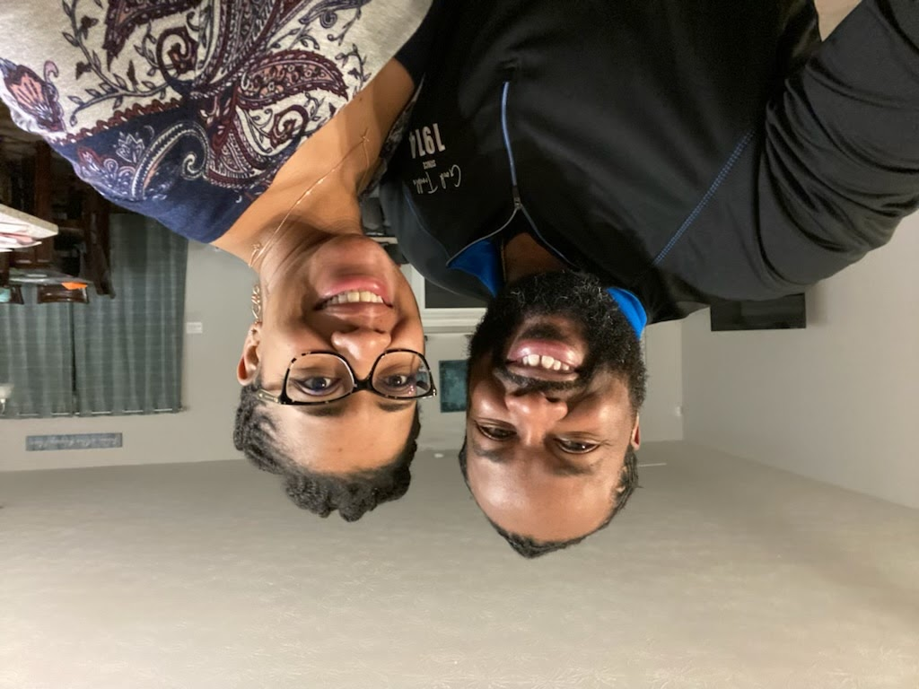
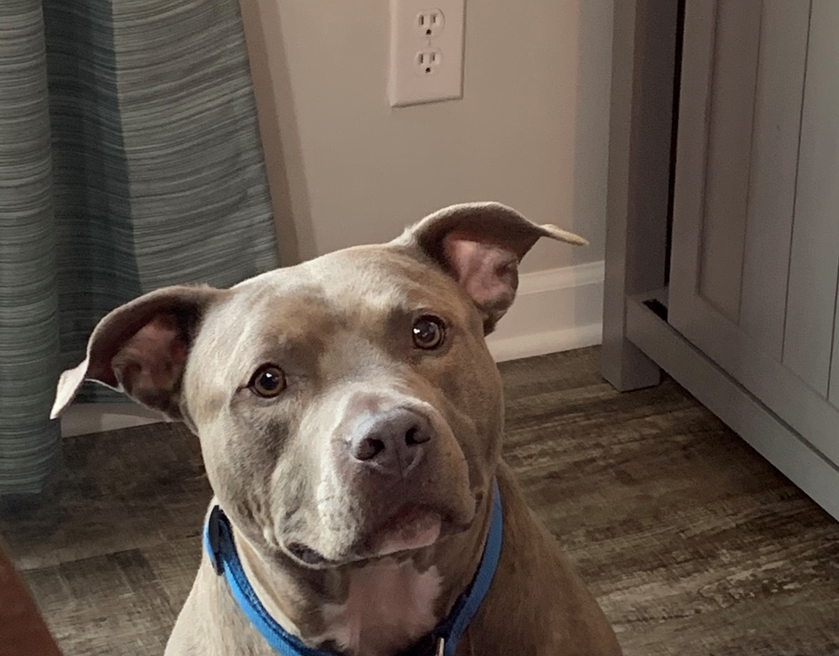

Slide 3
Recap
Principle #1CALLING :Nothing is more important in your life than being one of God’s tools to form a human soul
Ownership versus Ambassador parenting
God hasn’t made a mistake in tasking you with being His tool for the forming of the souls of our children
Principle #2 GRACE : God never calls you to a task without giving you what you need to do it. He never sends you without going with you.
God’s grace is needed in successful parenting

Slide 4
Law
Principle: Your children need God’s law, but you cannot ask the law to do what only grace can accomplish.

Slide 5
Law
Where are you placing your confidence?
What tool are you relying on to parent your children?
Is that tool of change the correct tool for the job?

Slide 6
Law
If rules and regulations had the power to change the heart and life of your child, rescuing your child from themselves and giving them a heart of submission and faith, Jesus would have never needed to come!

Slide 7
Law
God’s Law is the ultimate measuring system. It gives children:
The difference between right and wrong
Tracks to stay on
Boundaries to stay inside
Guiding and protecting wisdom
Grace of conviction

Slide 8
Law CANNOT
Give your child a heart
Create lasting change
Rescue
Redeem
Restore

Slide 9
Law
It is the sin inside our children that ruins everything, makes parenting difficult, demanding and exhausting, SO you (the Parent) must constantly exhibit and teach God’s grace to them.

Slide 10
Law
Use every opportunity to preach and model the Gospel to your children.

Slide 11
Inability
Principle: Recognizing what you are unable to do is essential to good parenting

Slide 12
Job Description
Driver- Road laws
Medical professionals- Scope of practice
Christian Parents- Guidelines, Instruction By laws, Commandments
Tools to help Him form a human soul

Slide 13
Change

Slide 14
Strategies
Fear
Reward
Shame

Slide 15
Strategies
Why do we use those “strategies”?
Tried
Interfere with your life
Temporary effect with the potential of long-lasting effects!
Fear of no one
Expects reward with job and school
Lack of confidence

Slide 16
Work
God has given us the authority for the work of change, but not the power to make that change happen.
Faithfully humble ourselves in being willing to participate in God’s work of change
If we could change people, then Jesus wasn’t needed.

Slide 17
Inability
God has simply called you as a parent to be humble and faithful tool OF (not TO) change in the lives of your children

Slide 18
Identity
Principle: If you are not resting as a parent in your identity in Christ, you will look for identity in your children

Slide 19
Love Struggle Vs Identity Struggle
Do you ever wonder why your children hurt you so much, make you angry and steal your joy?

Slide 20
Identity
Parenting is always shaped by where one looks for identity
All our actions and reaction are connected to who we think we are and what we value
If you are not resting in your vertical identity, you will look horizontally finding yourself and reason for living in something in the creation.

Slide 21
Identity
It very natural to get lost in a role
Identity Amnesia
2 Peter 1:8-9

Slide 22
How do you know if you are lost?
Too much focus on success
Too much concern about reputation
Too great a desire for control
Too much emphasis on doing rather than being
Too much temptation to make it personal

Slide 23
Refocus
God does not bring us to it without getting us through it!
His promise is real and true
Don’t make it harder than what it needs to be
You are a tool of change in forming of a human soul
Work life balance

Slide 24
Take Away
God’s grace not God’s law can only change children’s heart
Recognizing what you are unable to do is essential to good parenting
Lasting change occurs when there is change in the heart
Identity amnesia is real and very natural just like a workaholic!

Slide 25
Next Week
Same time, Same place
Discussing principles Process, Lost, Authority
This presentation was recorded for later viewing
The PowerPoints slides will also be available

