Slide 1
Parenting class

Slide 2
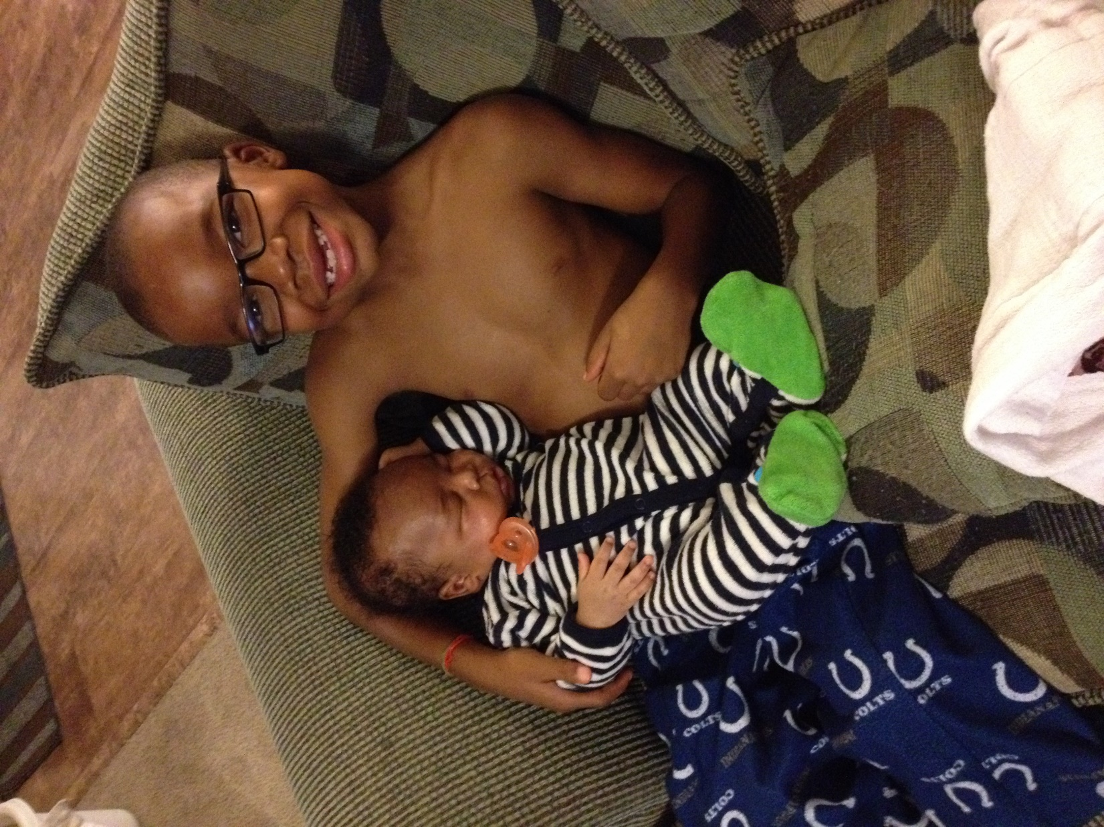
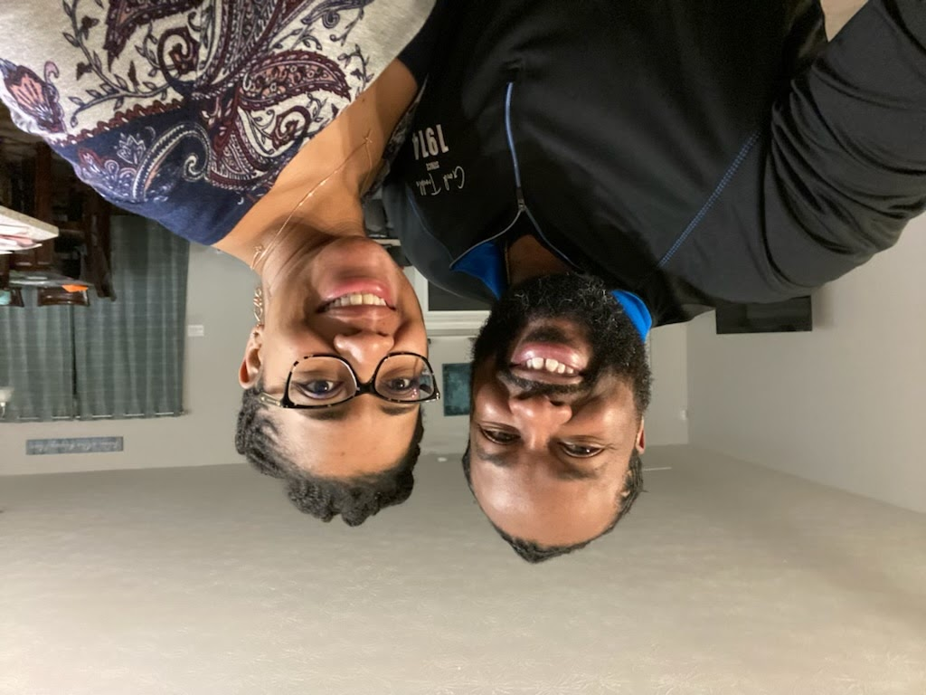
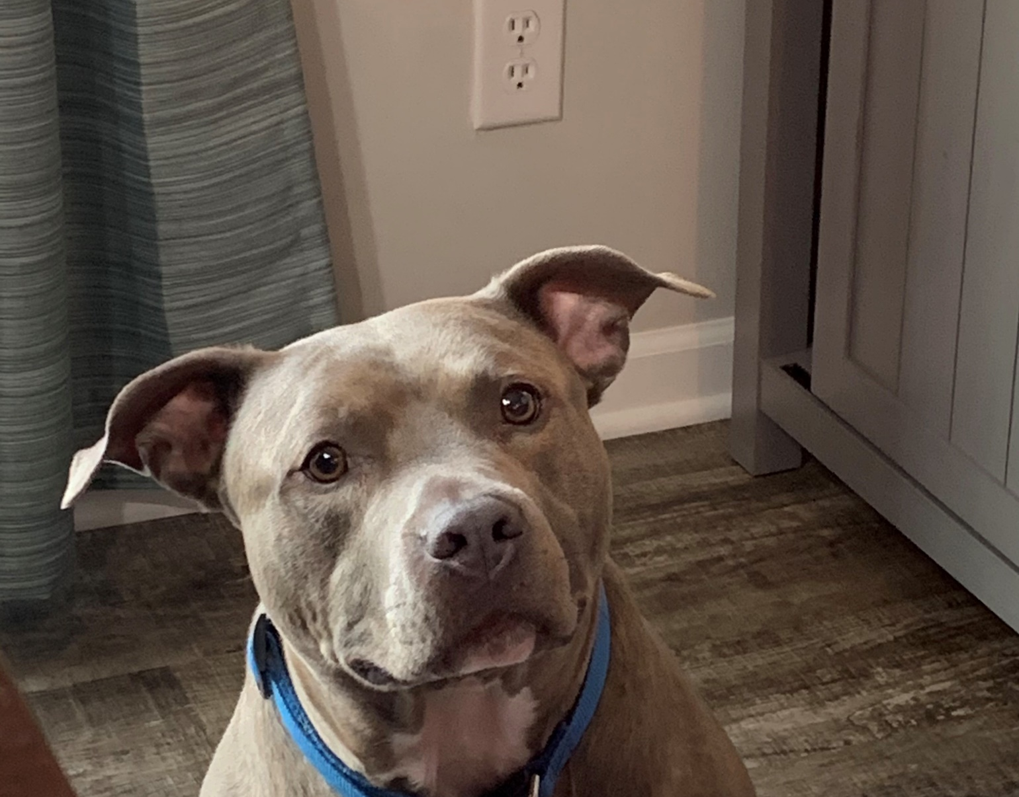

Slide 3
Recap
God’s Law, is the ultimate measuring system, it gives children the difference between right and wrong ,tracks to stay on, boundaries to stay inside, guiding and protecting wisdom, grace of conviction
Law cannot Give your child a heart, create lasting change, rescue, redeem, restore
Use every opportunity to preach and model the Gospel to your children.
Recognizing your inability is essential to good parenting

Slide 4
Process
Principle: You must be committed as a parent to long-view parenting because change is a process and not an event.

Slide 5
Process
Parenting is not a series of dramatic-confrontational-confession events, but rather a life-long process of incremental awareness and progressive change.

Slide 6
Process Pitfall
Identity
Ownership
Inconsistent
Having Unrealistic Expectations.
Not giving their children enough quality time
This Photo by Unknown Author is licensed under CC BY-NC

Slide 7
The Blind Leading the Blind
Sin blinds
Spiritual blindness
Don’t know that you are blind
Physical blindness
You know that you blind
Understanding this alters the way we need to think about the parenting process.

Slide 8
Parenting, the Never-Ending Conversation
Parenting the Process

Slide 9
How to change our view of parenting
1. You need to parent with a process mentality
Life-long connected process
Unfinished people used as agent of transformation in unfinished people
2. You need to see parenting as one unending conversation
Many mini-moments of change
3. You need to parent with a project mentality
Reactive parenting vs active parenting

Slide 10
Parenting the process
Calling
Humble and willing instrument of change in the hands of the one and only author of change
“Fruits of the Spirit”
Grace
Death and Resurrection of Jesus
Galatians 5

Slide 11
Lost
Principle: As a parent you’re not dealing with the bad behavior, but a condition that causes bad behavior.

Slide 12
Lost
What does it mean to be lost?
‘For the Son of Man came to seek and to save the lost’. Luke 19:10
Be sure to focus on the condition that produces the behavior.

Slide 13
Lost
The Parable of the Lost sheep
The Parable of the Lost Coin
The Parable of the Prodigal Son

Slide 14
Lost
The two biggest lies your child WILL believe:
Autonomy
Self-sufficiency

Slide 15
Lost
Our children need:
Insight: Help them understand the condition of danger that causes their behavior to disruptive.
Compassion: Parents need who mourn and long for them to be found
Hope: Need to know that God sent Jesus for them and that so that when they confess their cry for help. Parents need to share this hope through Jesus.
Rescue: This a heart rescue, be the tool God needs to create the heart change in every opportunity.
Wisdom: Need to learn to say ‘No’ to self.

Slide 16
Authority
Principle: One of the foundational heart issues in the life of every child is authority. Teaching and modeling the protective beauty of authority is one of the foundations of good parenting.

Slide 17
Authority
Authority Issues:
Submission to another that is not me is unnatural for a sinner.
Self-rule delusion
To reject authority is to reject God, who is the authority over all authority, and rejection of God never has and never will go anywhere good.

Slide 18
Authority
2 Corinthians 5:15And he died for all, that those who live should no longer live for themselves but for him who died for them and was raised again.
Ephesians 4:1Children, obey your parents in the Lord, for this is right. 2“Honor your father and mother”—which is the first commandment with a promise— 3“so that it may go well with you and that you may enjoy long life on the earth.” 4Fathers, do not exasperate your children; instead, bring them up in the training and instruction of the Lord.

Slide 19
Authority work is grace work
Exercising ambassadorial authority
Helping your children to understand why they do what they do
Establishing authority in the little things

Slide 20
Authority work is grace work
Exercising consistent authority
Confessing that when it comes to authority your are more like your children than unlike
Discussion of authority, talking about the cross of Jesus Christ.

Slide 21
Take Away
Parenting is a life-long process for you and your child(ren).
Parenting is not a solo process, you are not alone.
All children are born lost, we are to be God’s tool in their process to find Him
All sinners are lost and resistant to authority, they need deliverance, acceptance, compassion, patience, and grace.
The struggle with authority displays how much a hold sin had on one’s life.

Slide 22
Next Week
October 24 : Single Parenting
October 31: Trunk or Treat, 2-5pm New Era Church Parking Lot
The PowerPoints Presentations will be available to download.
Please invite your family and friends to the class!!

