Slide 1
Parenting Class

Slide 2
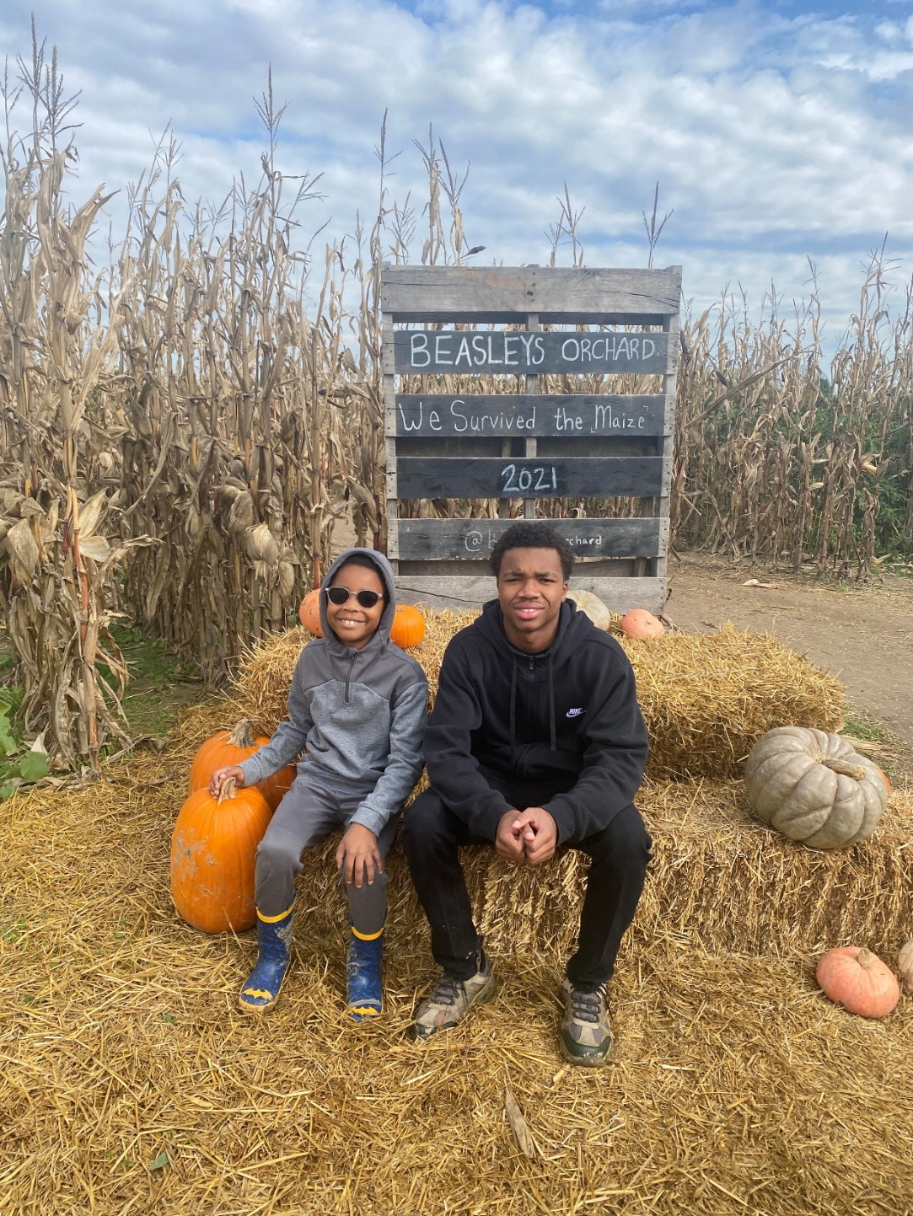
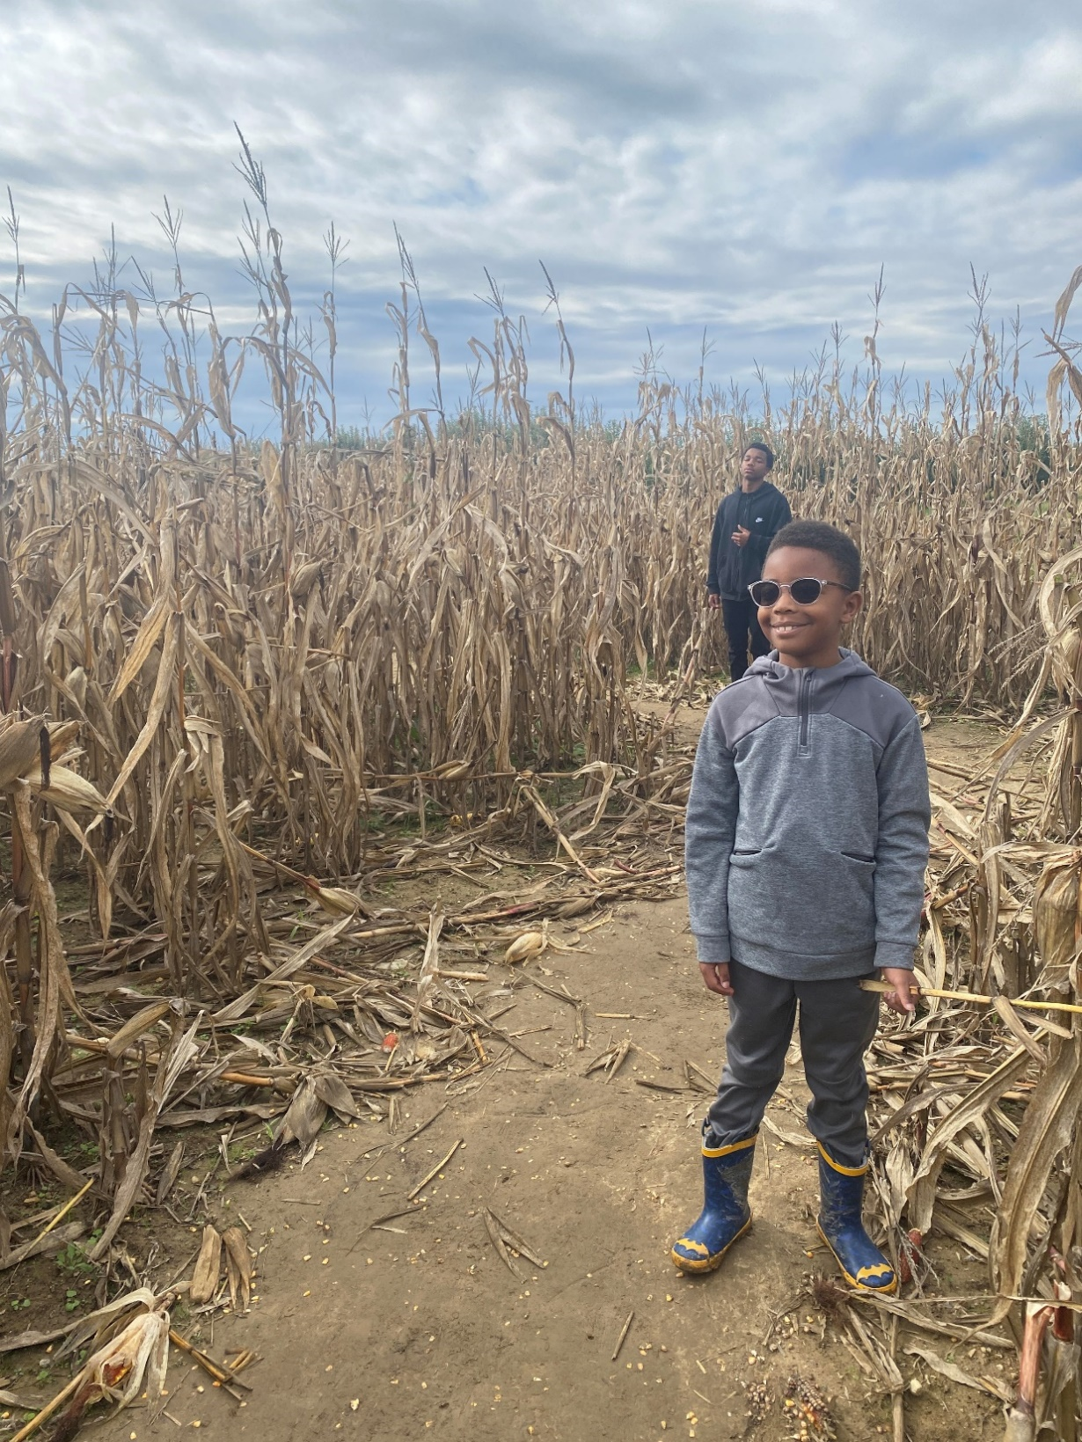
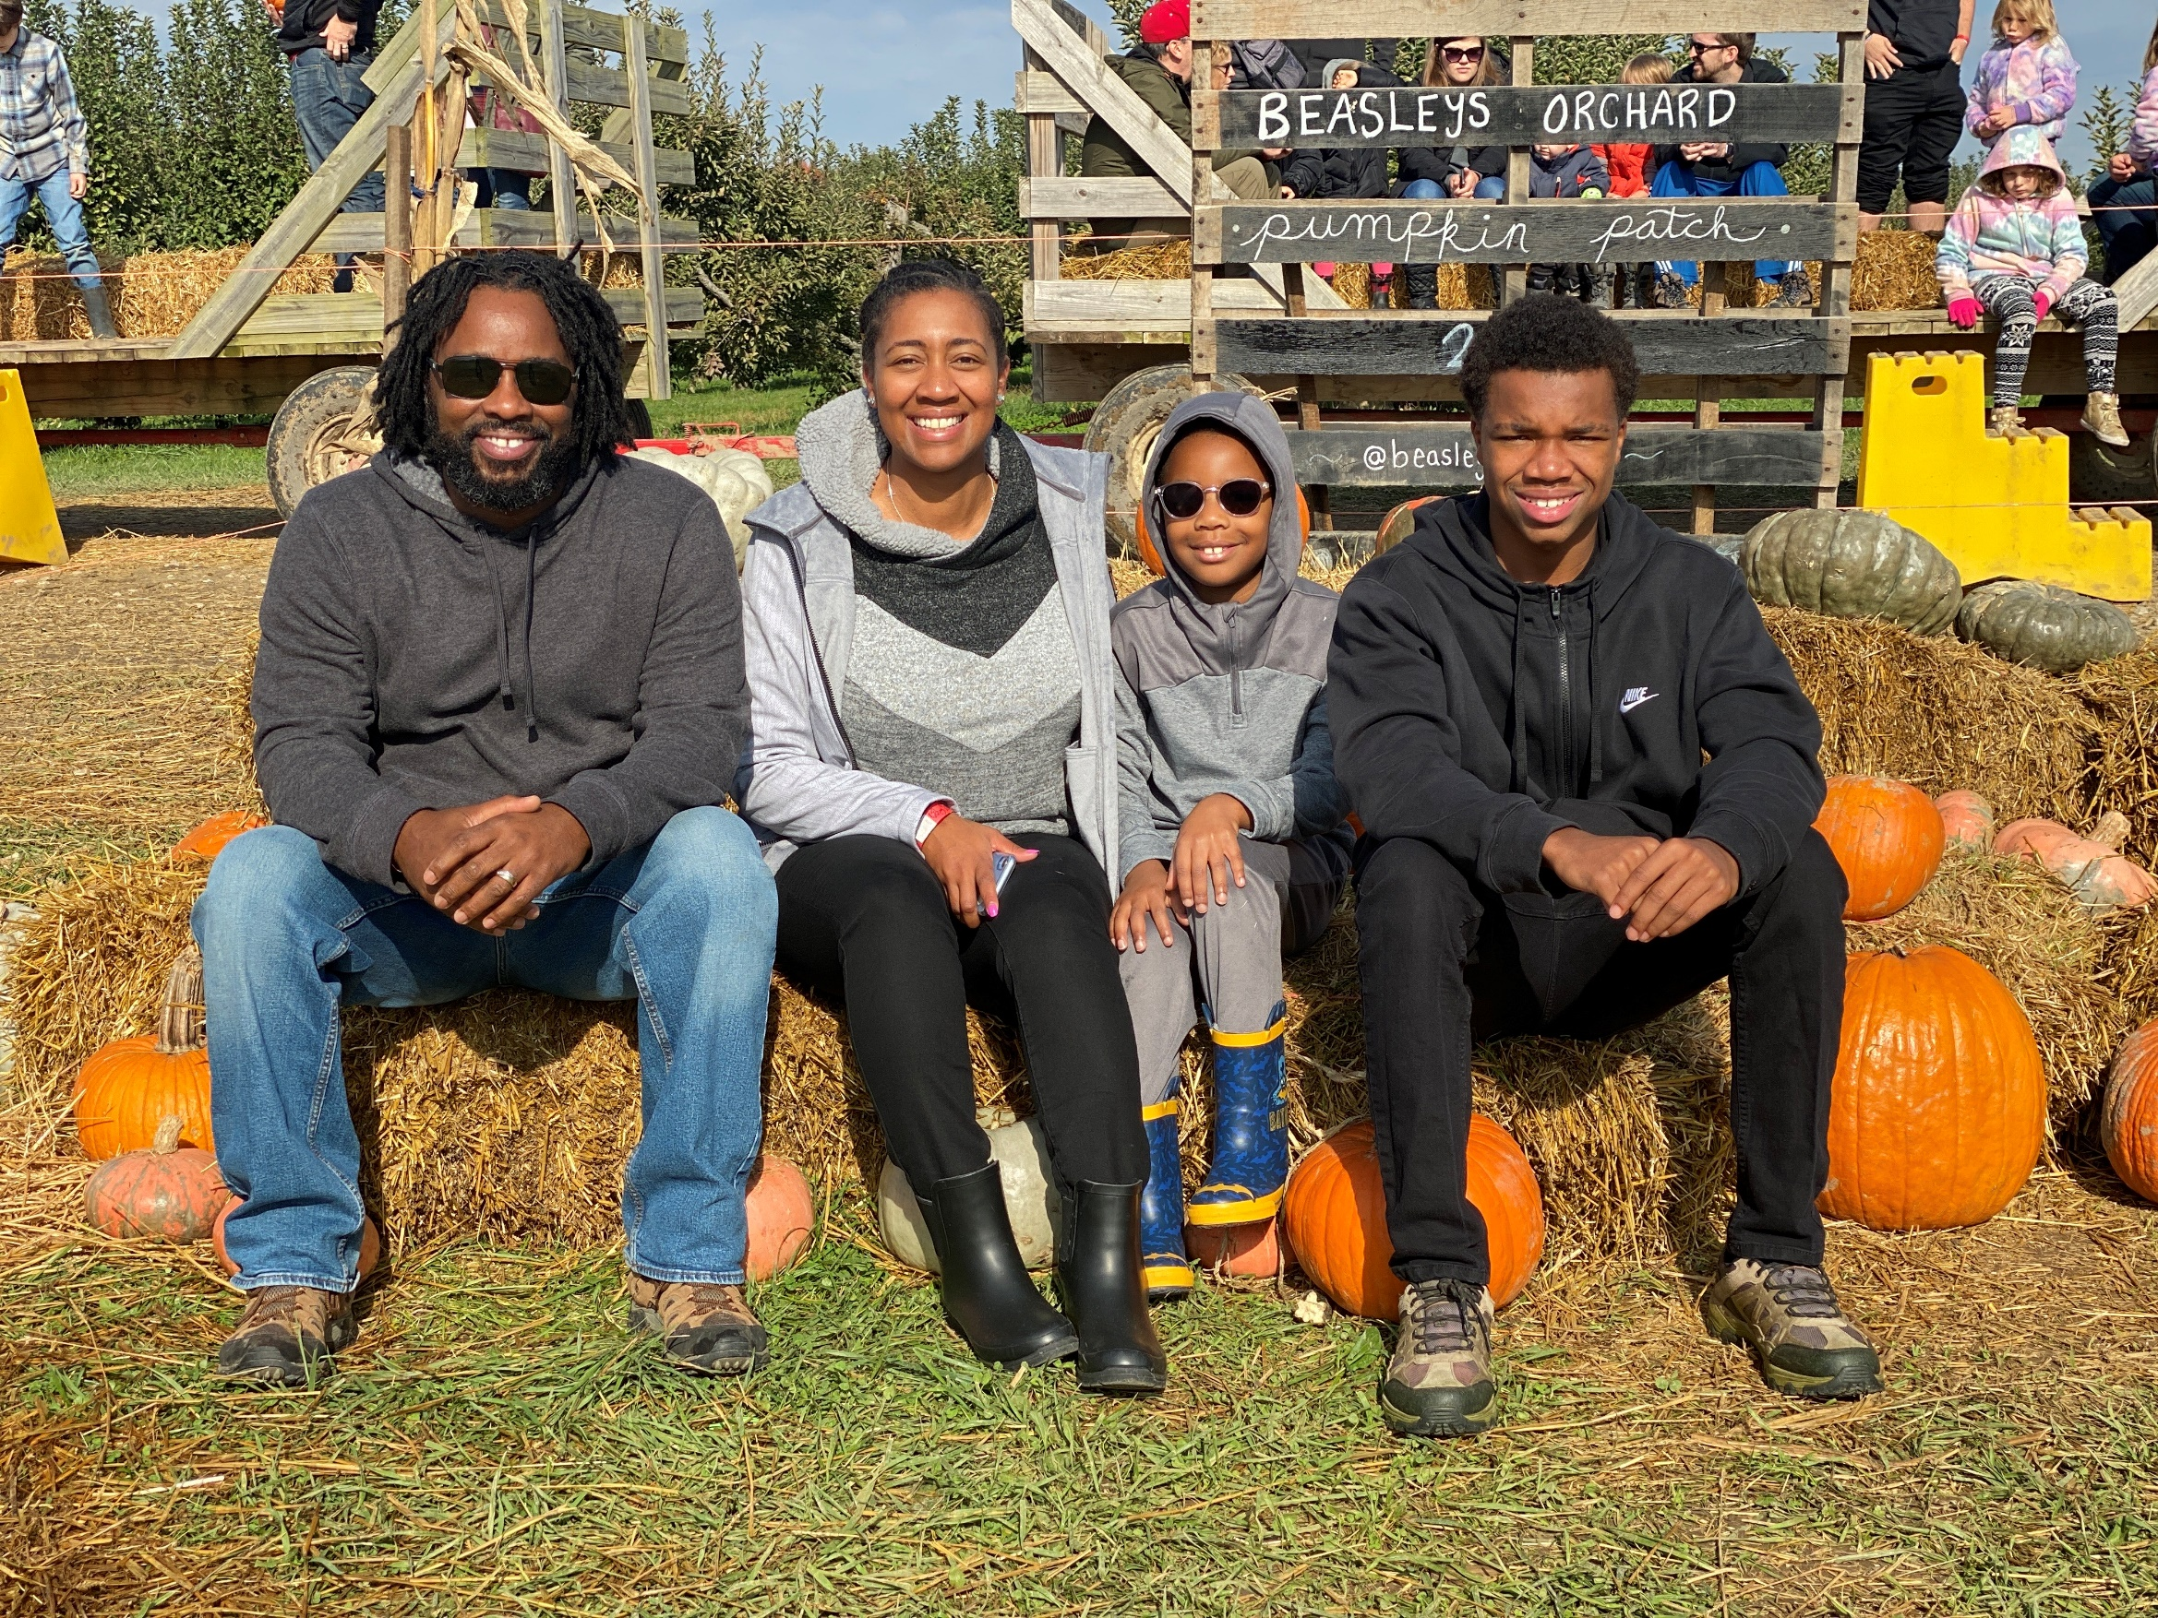

Slide 3
Principles that can Radically Change your Family
Calling : Nothing is more important in your life that being one of God’s tools to form a human soul
Grace : God never calls you to a task without giving what you need to do it, He never sends you without going with you.
Law : Your children need God’s law, but you cannot ask the law to do what only grace can accomplish
Inability : Recognizing what you are unable to do is essential to good parenting
Identity : If you are not resting as a parent in your identity in Christ, you will look for identity in your children.

Slide 4
Principles that can Radically Change your Family
Process : You must be committed as a parent to long-view parenting because change is a process and not an event.
Lost : As a parent you’re not dealing just with bad behavior, but a condition that causes bad behavior
Authority : One of the foundational heart issues in the life of every child is authority. Teaching and modeling the protective beauty of authority is one of the foundations of good parenting

Slide 5
Principles that can Radically Change your Family
Foolishness : The foolishness inside your children is more dangerous to them than the temptation outside of them. Only God’s grace has the power to rescue fools.
Character : Not all the wrong your children do is a direct rebellion of authority; much of the wrong is the result of a lack of character.
False Gods : You are parenting a worshipper, so its important to remember that what rules your child’s heart will control his behavior

Slide 6
Control
Principle:
The goal of parenting is not control of behavior, but rather heart and life change.

Slide 7
Control?
Co-pilots?
Assistant Manager?
Agent in Change?

Slide 8
Delivery Agents God does call us to exercise daily control over our children.
Parental Control &
Faithful Control
God’s Law & household rules (Ps. 19:7, )
Instruction/Guidance (Prov. 11:14, Ps. 25:8)
Protect (Ps 91:1)
Prepare (Prov. 16.9)
Understanding (Ps. 119:99)
Security (Job 24:23)
Wisdom (James 1:5)
Confront (Ps 94:10)
Discipline (Deut. 8:5)
Structure (Jer.29:11)
Authority (Rom. 13:1)
Discipline (Deut. 8:5)
Love (John 3:16)
Forgiveness (Col. 3:13)

Slide 9
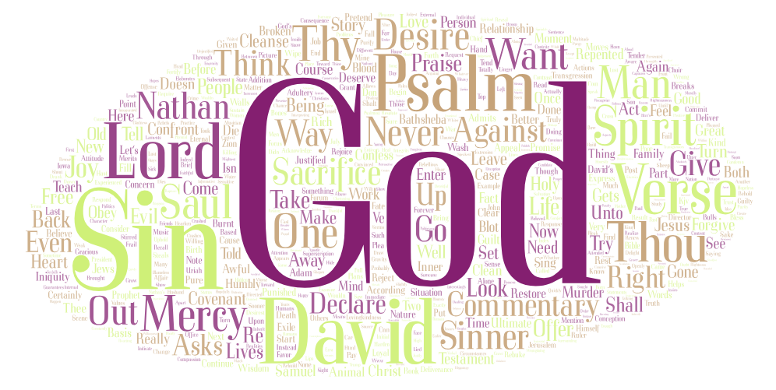
Deeper need…Heart Change
David's Confession
Psalms 51
Understanding of the deeper need
Better parenting

Slide 10
Psalm 51 break down
Children need to see their sin, so they will cry out for God’s Mercy.
Children need to understand the nature of sin, so they don’t minimize its danger (v.1-3)
Children need to understand that their problem is not with their parents, but with God (v.4)
Children need to understand that sin is a nature problem that produces behavior problems (v.5)
Children need to understand that since sin is a heart problem, the only solution is a new heart (v.10)
Children need to be taught to run to the only Hope: the forgiving Grace of God (v.14)

Slide 11
Parental and Faithful Control
Job of Jobs…
Better understanding, better parenting.
Ask for grace, this will allow God to do what we can’t do, heart change.
He is with us (parents) and provides every single thing needed.

Slide 12
Rest
Principle:
It is only rest in God’s presence and grace that will make you a joyful and patient parent.

Slide 13
The Struggle is Real
Jobs of Jobs
Delivery Agent
Agent in Change
Disciplines
Protection
Teacher
Transporter
Chief
Listening ear
Gamer player
Laundrist
Volunteer

Slide 14
God forgetful!
Focus on the child's needs and our struggles
Carry everything on our shoulders
Overwhelmed, defeated and guilt
Worry and fear, weakened
Aloneness… (cruel lie that tear us down)

Slide 15
Help!
Turn to the bible for guidance
& understanding
Ephesian 6:1-4
Most common practical and helpful parenting passage
Matthew 28: 18-20
Great Commission
Provides real hope and help to every Christian parent!

Slide 16
Great Commission meaning for parenting
Is to raise children to approach everything as a disciples of Jesus.
To teach them to observe everything that Jesus has commanded.
To learn to look at life through the lens of the will and plan of the Creator.
To think about everything in a way that is pointedly God-centered.

Slide 17
Help!
They will become his disciples only as they are rescued by his grace
Parents Job
Every day to faithfully participate in what is impossible for us to produce
Remember His promise
Rest in his promise

Slide 18
Here is our help and hope
You will not be punished for your failure
Your are welcomed by grace to new beginnings.
You are not left to your limited resources
God blesses you with the right here, right now wisdom of his word
You do not have to load the burden of your children's welfare on your shoulders every morning.
God will never close his ears to your cries for help
Weakness is not a curse; it’s a blessing
Success is about the faithfulness, not results

Slide 19
Mercy
Principle: No parent gives mercy better than one who is convinced that he desperately needs it himself.

Slide 20
Mercy
Tenderness and compassion toward someone in need
Leniency, clemency, compassion, grace, pity, forgiveness, forbearance, humanity, indulgence, generosity, kindness, sympathy
Some of the most needy people you know are our children
Guidance, protection, help and rescue, wisdom and instruction, confrontation and compassion, support and provision, to see God and themselves with accuracy
It’s about working to make the invisible mercy of God visible as we respond with mercy toward our children.

Slide 21
Mercy
“Surely goodness and mercy shall follow me all the days of my life, and I shall dwell in the house of the Lord forever” Ps 23:6
“As for you, O Lord, you will not restrain your mercy from me: your steadfast love and faithfulness will ever preserve me!” Ps 40:11
“The Lord is good to all, and his mercy is over all that he has made” Ps 145:9
“Therefore the Lord waits to be gracious to you, and therefore he exalts himself to show mercy to you.” Isa 30:18
“Let us then with confidence draw near to the throne of grace, that we may receive mercy ad find grace to help in time of need.” Heb 4:16

Slide 22
Mercy Is and Is not’s
Parenting with a tender heart
Being firm and unyielding and loving altogether
Viewing struggles with compassion
Discipline that is kind and correction that is gentle
Moving in moments with love when they don’t deserve it
Doing things over and over w/o throwing it in theirs faces.
Wishy-washy
Letting down standards
Acting as if the bad things they do is okay
Abandoning discipline and correction
Quit holding God’s law before your children
Not always saying yes and never saying no

Slide 23
Mercy
That every action, reaction, and response toward your children is tempered and shaped by tenderness, understanding, compassion, and love.
Mercy requires mercy. God will use your life and your children to show you the same mercies that you were and are given as example to show towards them.

Slide 24
Responses of Mercy
God has called you to be the first responders in the lives of your children
Looks for evert opportunity to shower your children with grace
Be careful to help your children see the heart behind the behavior
Be patiently committed to process
Point your kids every day to Jesus
Humbly accept your limits
Remind your heart each morning to rest in the presence and power if your heavenly Father.

Slide 25
Responses of Mercy continued
Willingly confess your faults.
Root all you require, say, and do in the wonderful wisdom of Scripture.
Don’t treat opportunities like hassles.
Be slow to anger and quick to forgive.
Pray before, during and after.
Do all of these things over and over and over again.

Slide 26
Summary
Remember the One who sent you, teach our heart to rest in Him and His promises.
Bringing unrest to your parenting never goes well.
If all that our children needed was good instruction in order to live as God designed , then, I repeat, the life, death, and resurrection of Jesus wouldn’t have been necessary.
They need divine intervention, heart change that only God can do.

Slide 27
Coming up…
December 12: Doing it Again, grandparents as parents
December 19 : ReCap and Evaluation
The PowerPoint Presentations are available to download on the New Era website.
Please invite your family and friends to the class!!

